Slide 1


Vehicle Rental System CSE306: Internship-I
Internal Guide: Prof. Arpit Bhatt
External Guide: Darpan Bhatt-(W3Nuts)
Presented by : Veer Bhalodia (23DCS010)
Internship Duration : 12 May 2025 – 13 June 2025
Department of Computer Science & Engineering,
Devang Patel Institute of Advance Technology and Research (DEPSTAR)

Slide 2
Content of the Presentation
Introduction and Problem Definition
Objective
Tech Stack
Major Functionalities
Flowchart
Expected Output
Future Scope & Conclusion
Department of Computer Science & Engineering, DEPSTAR

Slide 3
Introduction and Problem Definition
Introduction: Why I Created This Project?
Renting vehicles can be a pain. The old way of doing it is often slow and confusing, but people want a quicker, more flexible way to travel.
To solve this, we built a Vehicle Rental System. This website makes renting a vehicle simple. It lets customers book easily and helps administrators manage everything smoothly.
Project Definition: What It Does?
Our project is a web application that makes vehicle rentals easier. It's a single platform that handles everything:
Customers: They can easily see what vehicles are available and book one in just a few clicks.
Administrators: They can manage all the vehicles, users, and bookings from one secure place.
In short, it's a simple and secure system that helps both customers and staff.

Slide 4
Project Objective
My main goals for this project were to create a fast, secure, and easy-to-use vehicle rental system. I focused on four key objectives:
Simplify the Rental Process: My first objective was to make booking and returning a vehicle as quick and simple as possible for customers.
Ensure Security: I built a secure system for users to sign up and log in, protecting their personal information.
Organize Vehicle Selection: I made it easy for users to browse vehicles by organizing them into clear categories like Bike, Sedan, and SUV.
Manage Data Safely: I used a database (MongoDB) to safely store and manage all the important information about users, vehicles, and bookings.

Slide 5
Tools and Technologies
Frontend: The user interface was built using React.js for its component-based architecture, which makes building dynamic pages efficient. I used Bootstrap 5 and CSS to handle the styling and ensure a responsive design that looks good on any device.
Backend: For the server-side logic, I used Node.js with the Express.js framework. This provided a fast and scalable environment to handle all the requests from the frontend.
Database: All the project's data—including information on users, vehicles, and bookings—is stored and managed in a MongoDB database.
API Calls: I used Axios to handle all the API calls, which allows the frontend and backend to communicate with each other.

Slide 6
Major Functionalities
User Side:
The customer side is designed to be simple and easy to use. Users can:
Register & Log In: Create an account and sign in securely.
Browse Vehicles: Explore vehicles by category like Bikes, Sedans, and SUVs.
Book & Cancel: Reserve a vehicle or cancel if their plan changes.
View History: Check all past and current bookings.
Admin Side:
The admin side is designed for managing the rental business. Admins can:
Manage Vehicles: Add, edit, or remove vehicles.
Manage Users: View and manage all registered users.
Track Bookings: Monitor active and past bookings.

Slide 7
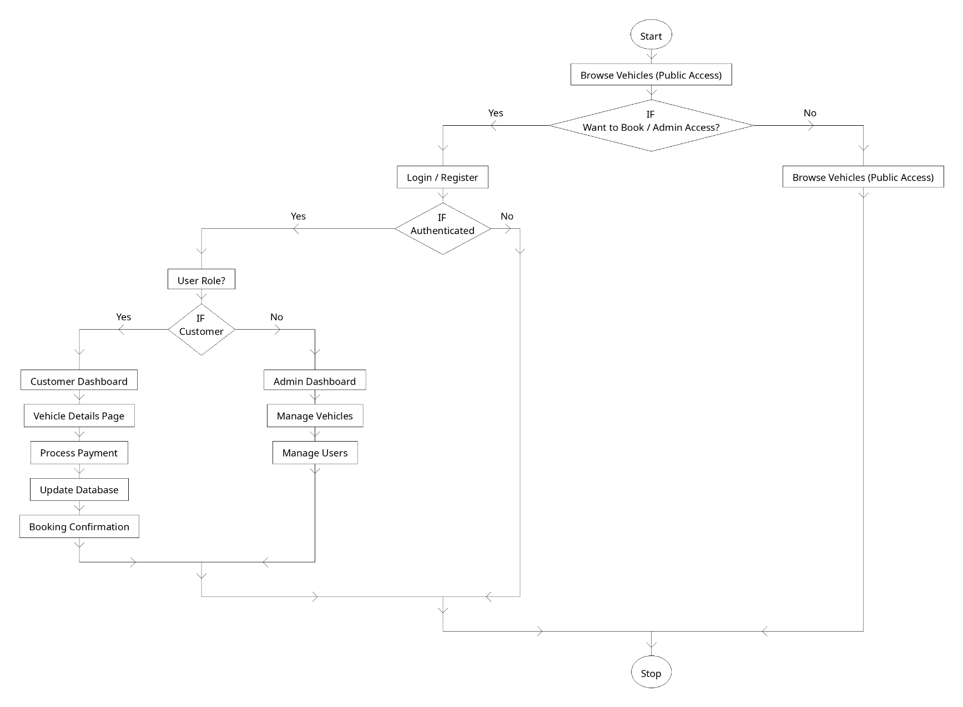
Flowchart

Slide 8
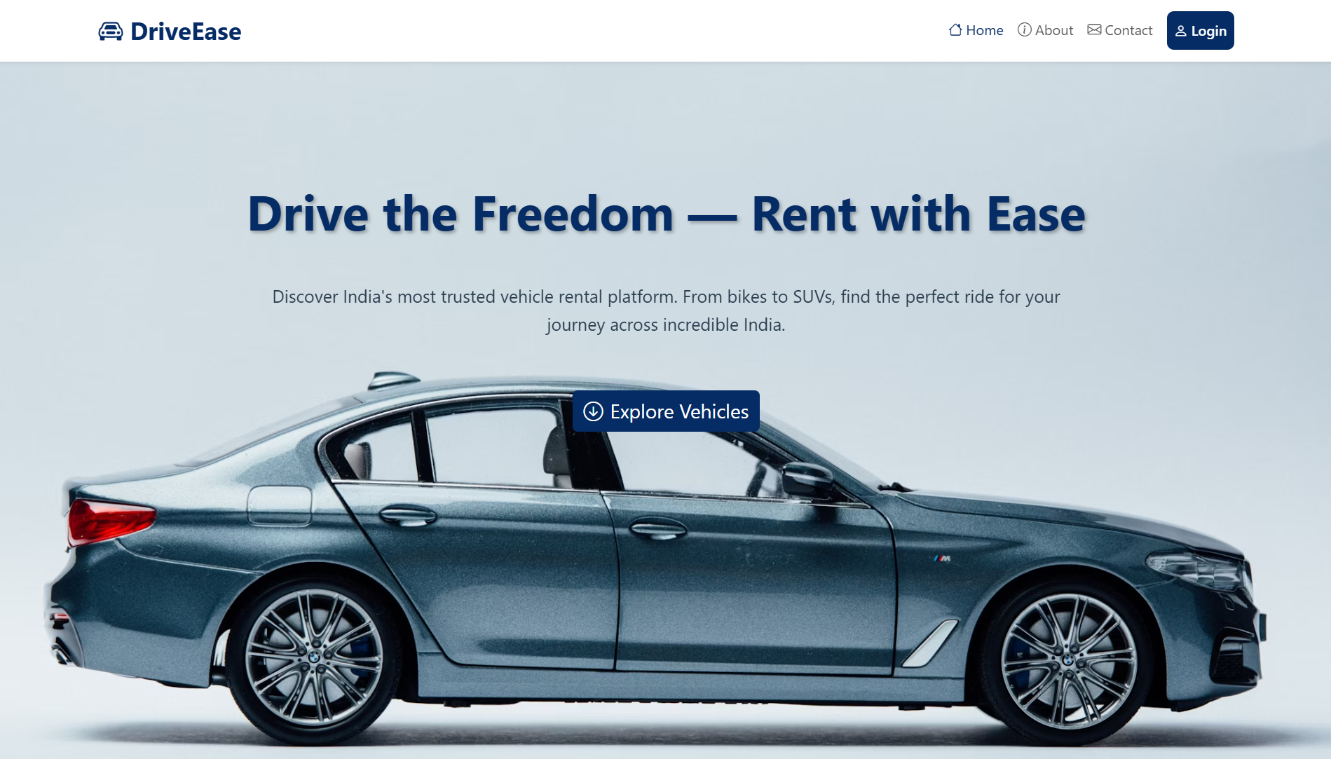
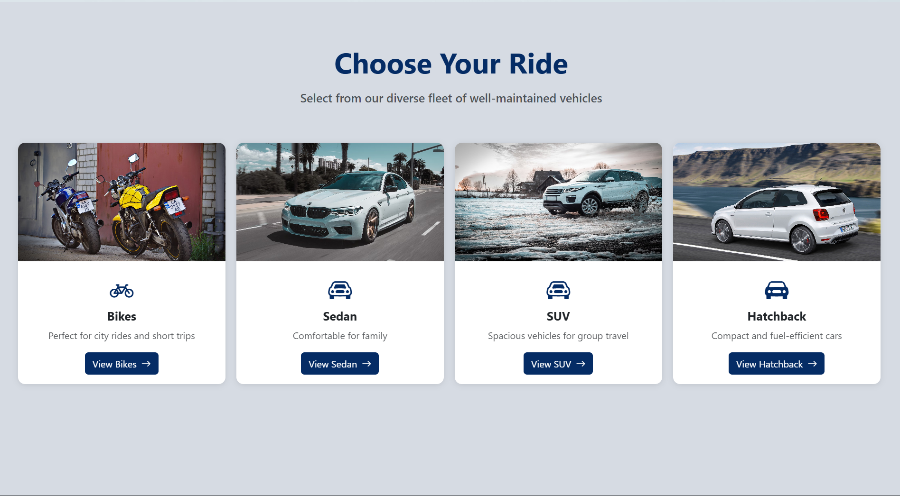
Result:

Slide 9
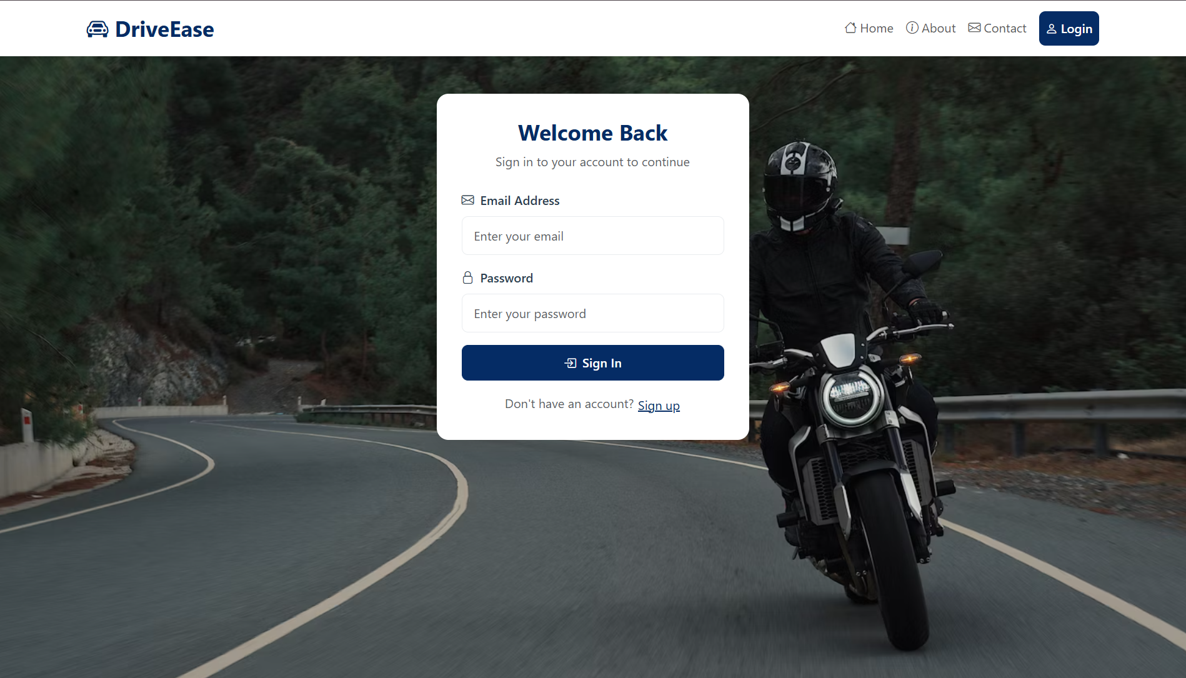
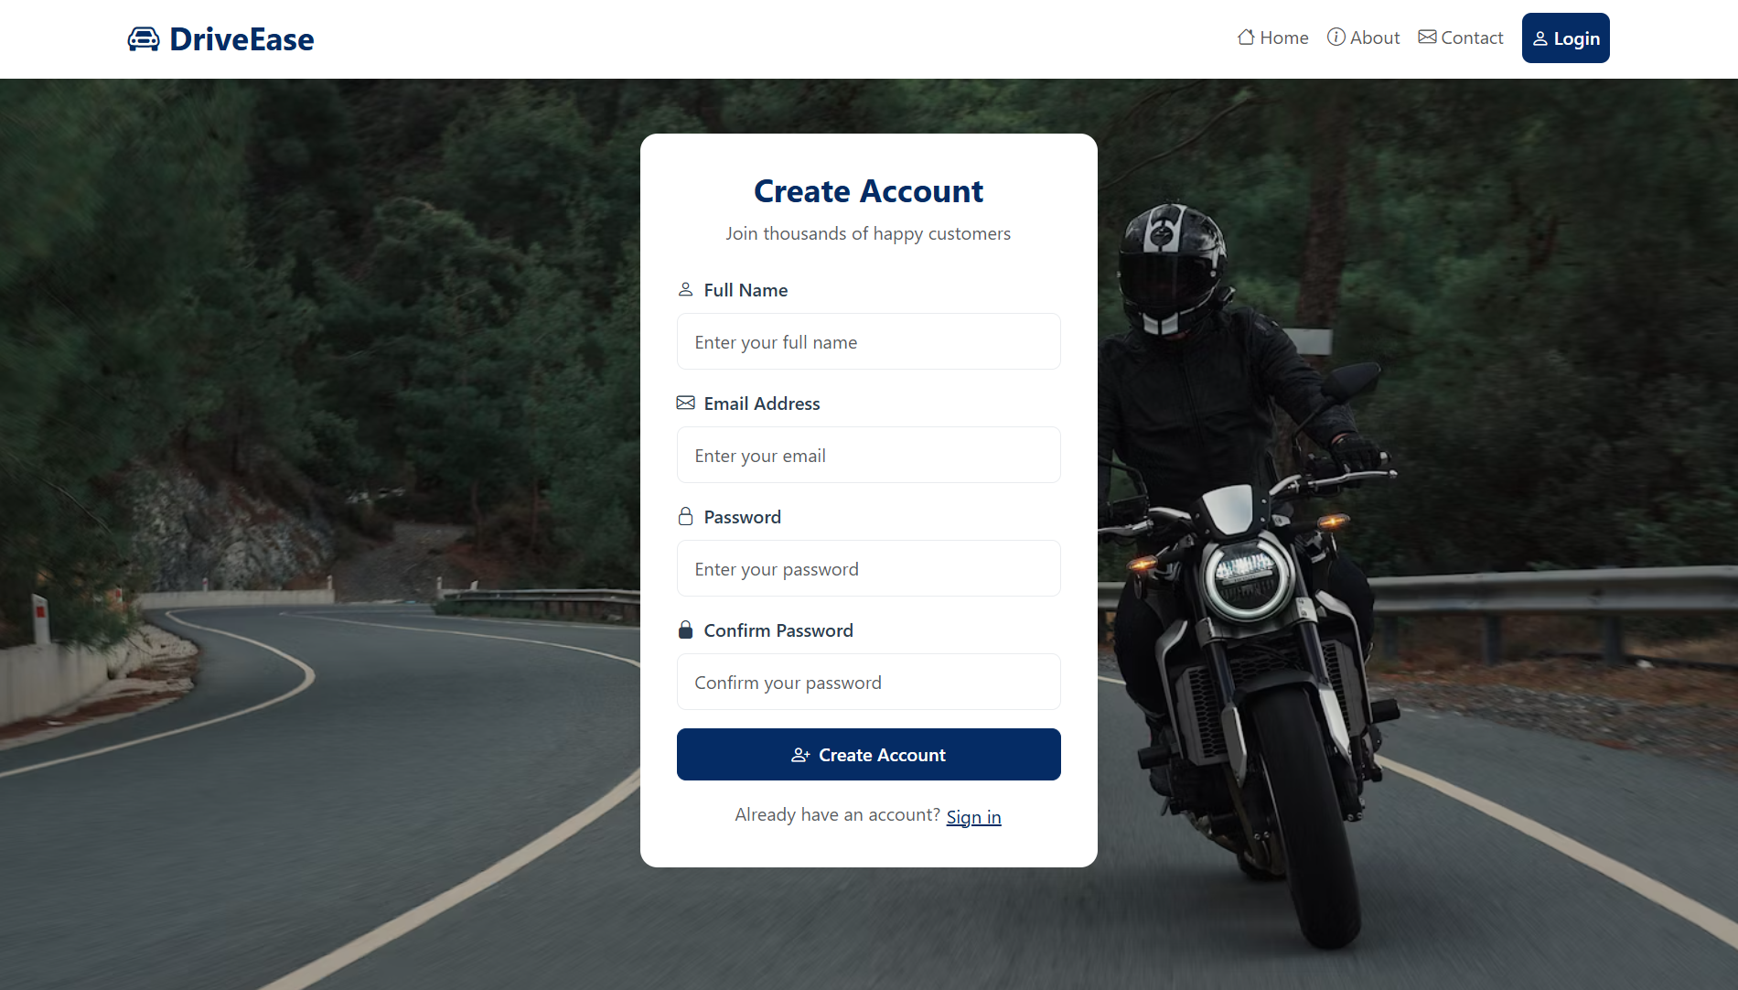
Result:

Slide 10
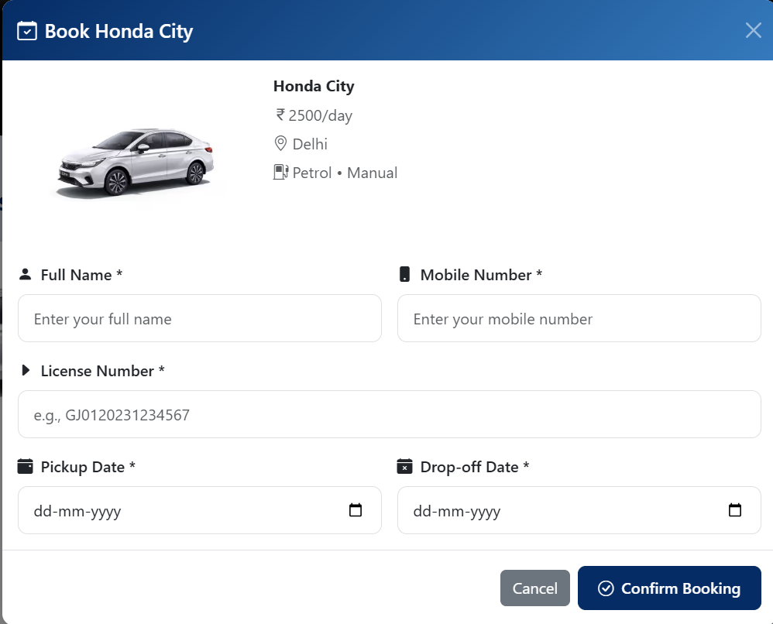
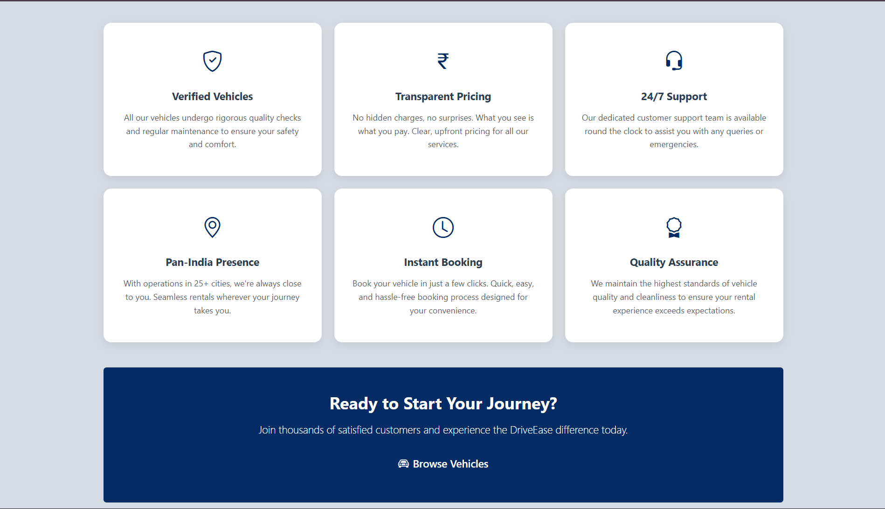
Result:

Slide 11
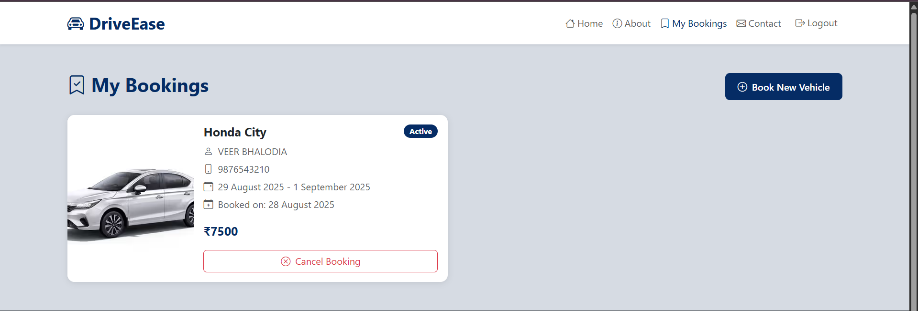
Result:

Slide 12
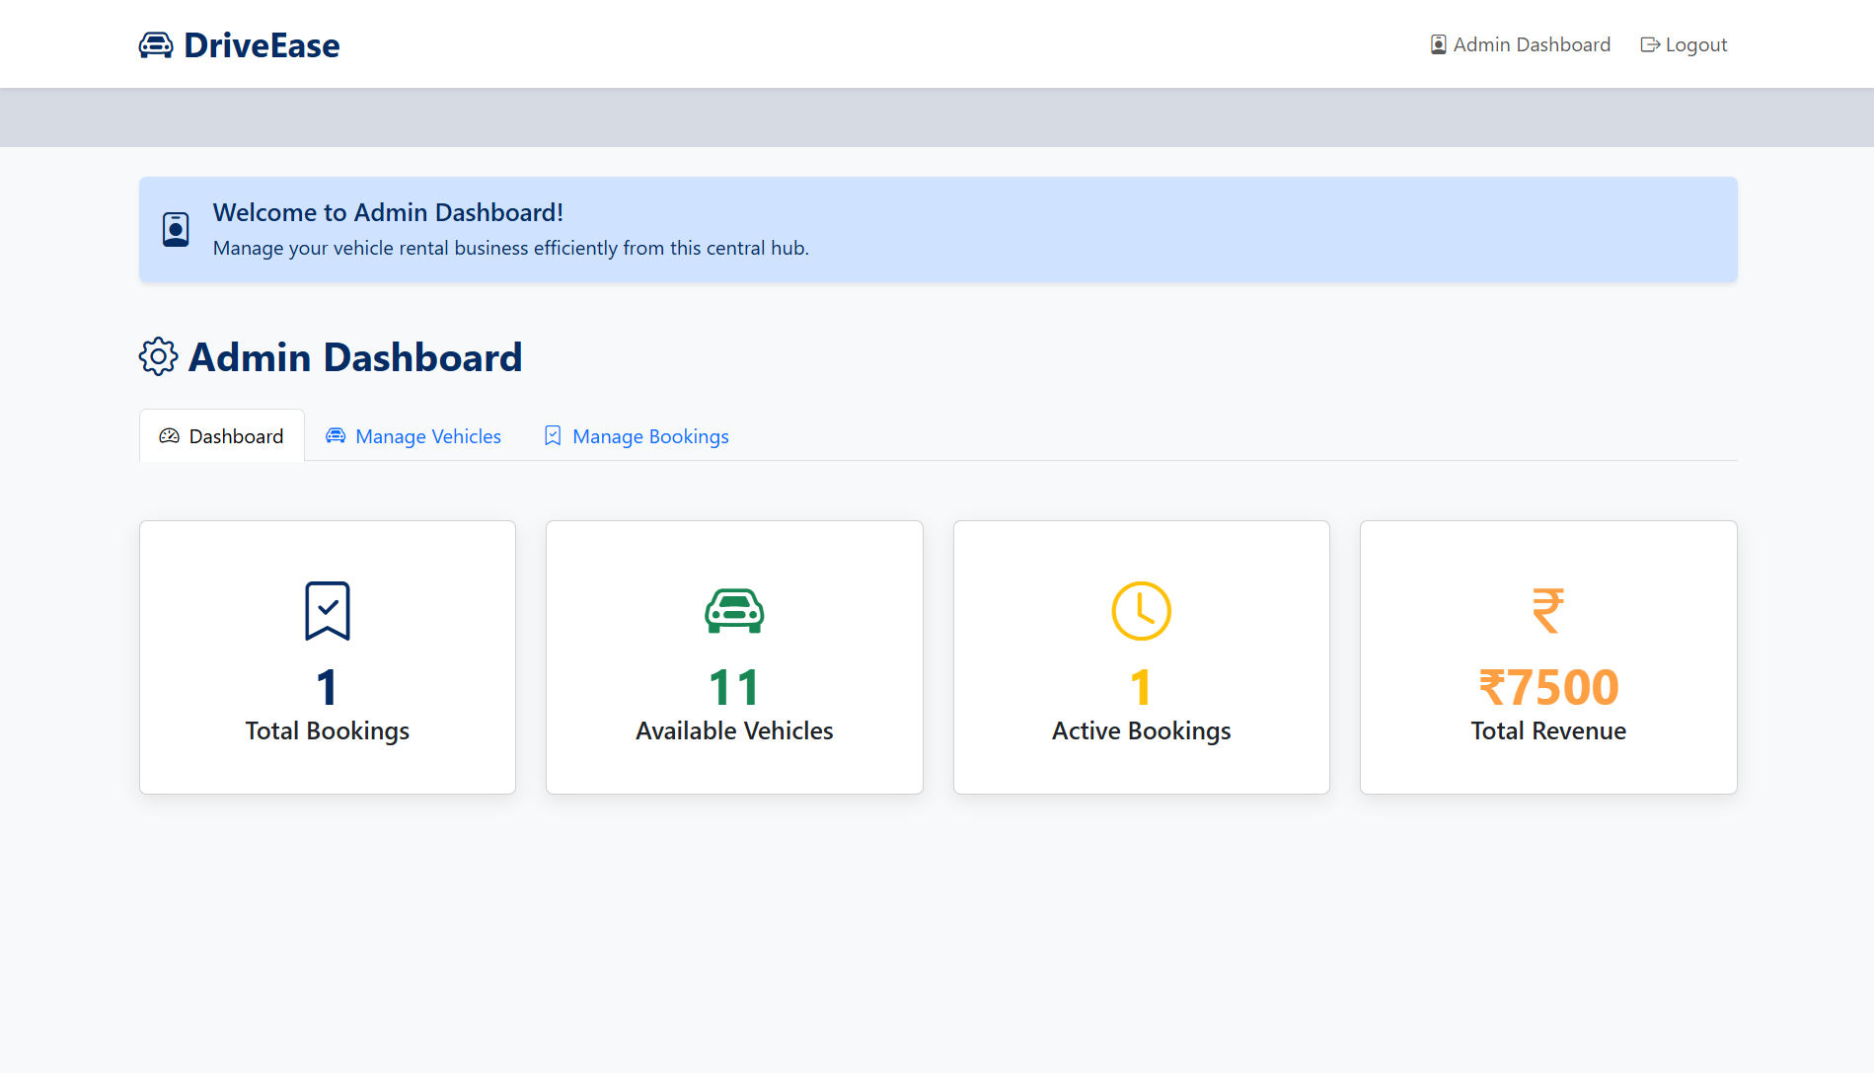
Result:

Slide 13
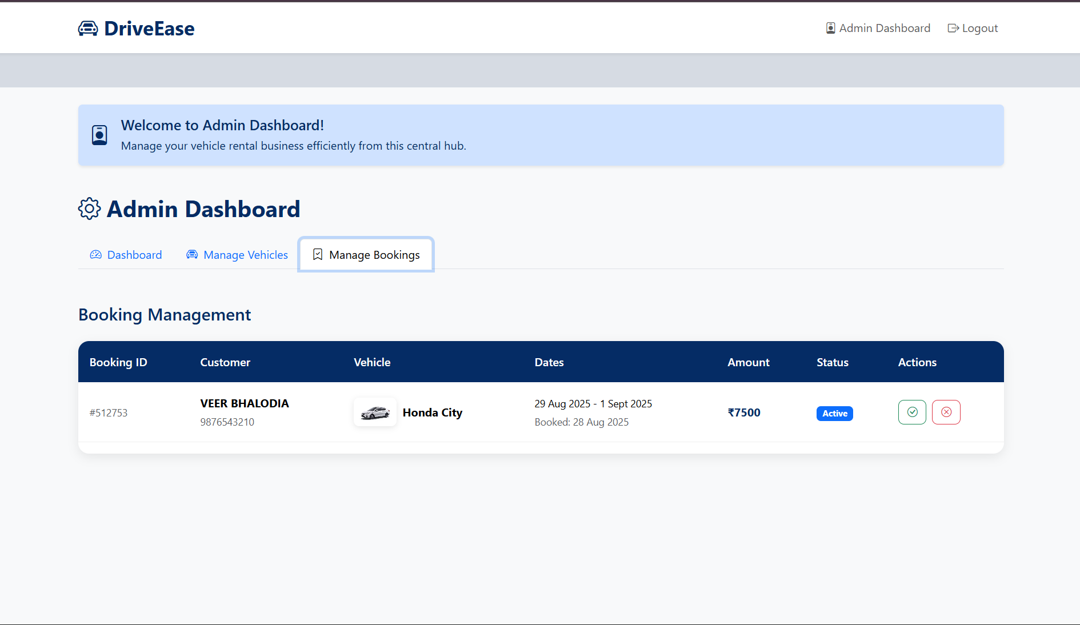
Result:

Slide 14
Limitations and Outcomes
Limitations:
No online payment integration: The system currently does not support direct online payments.
Web-based only: The application is accessible only via web browsers and does not have a native mobile app version.
Limited tracking features: Vehicle tracking functionality is basic and can be further enhanced for more detailed monitoring.
Outcomes:
Automated booking process: The system successfully automates vehicle bookings, making the process faster and more efficient.
Real-time vehicle availability: Provides a clear, up-to-date view of available vehicles, benefiting both customers and administrators.
Reduced manual errors: Automation significantly minimizes human errors in bookings and data management.

Slide 15
Future Scope
Online payment gateway: Enable direct online payments for seamless booking.
Mobile application (Android/iOS): Develop a native app to improve accessibility and user experience.
GPS tracking for vehicles: Implement real-time tracking for better fleet management.
AI-based vehicle recommendations: Suggest vehicles to users based on preferences and past bookings.

Slide 16
References and Conclusion
References:
https://reactjs.org/ – Official documentation for React.js, used for building the frontend. https://developer.mozilla.org/ – Reference for HTML, CSS, and JavaScript fundamentals. https://nodejs.org/ – Used for backend development and server-side scripting. https://expressjs.com/ – Reference for building RESTful APIs using Express.js. https://www.mongodb.com/ – Used to understand NoSQL database structure and integration
Conclusion:
In short, this project successfully built a functioning Vehicle Rental System that makes the booking process simple for users and provides efficient management tools for administrators. Creating it was a great opportunity to learn and apply the MERN stack, which will be invaluable for future projects.

Slide 17
Thank You

